Slide 1
Database Planning, Design and Management I

Slide 2
MODULE 1V
Normalization

Slide 3
Module Summary
Definition
Objectives of normalization
Forms of normalization:
- First Normal Form
- Second Normal Form
- Third Normal Form
Functional dependencies and primary keys
Data redundancy and update anomalies

Slide 4
Normalization
Normalization is a process of organizing the data in database to avoid data redundancy, insertion anomaly, update anomaly & deletion anomaly.
Let’s discuss about anomalies first then we will discuss normal forms with examples.
Anomalies in DBMS
There are three types of anomalies that occur when the database is not normalized. These are – Insertion, update and deletion anomaly. Let’s take an example to understand this.
Example: Suppose a manufacturing company stores the employee details in a table named employee that has four attributes: emp_id for storing employee’s id, emp_name for storing employee’s name, emp_address for storing employee’s address and emp_dept for storing the department details in which the employee works.
At some point of time the table looks like this:

Slide 5
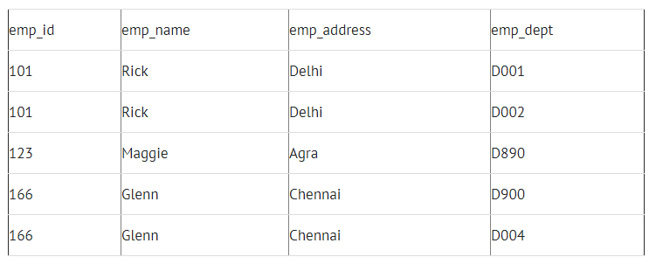

Slide 6
Anomalies in DBMS Cont…
The above table is not normalized. We will see the problems that we face when a table is not normalized.
Update anomaly: In the above table we have two rows for employee Rick as he belongs to two departments of the company. If we want to update the address of Rick then we have to update the same in two rows or the data will become inconsistent. If somehow, the correct address gets updated in one department but not in other then as per the database, Rick would be having two different addresses, which is not correct and would lead to inconsistent data.
Insert anomaly: Suppose a new employee joins the company, who is under training and currently not assigned to any department then we would not be able to insert the data into the table if emp_dept field doesn’t allow nulls.
Delete anomaly: Suppose, if at a point of time the company closes the department D890 then deleting the rows that are having emp_dept as D890 would also delete the information of employee Maggie since she is assigned only to this department.
To overcome these anomalies we need to normalize the data.

Slide 7
First normal form (1NF)
Normalization
Here are the most commonly used normal forms:
First normal form(1NF)
Second normal form(2NF)
Third normal form(3NF)

Slide 8
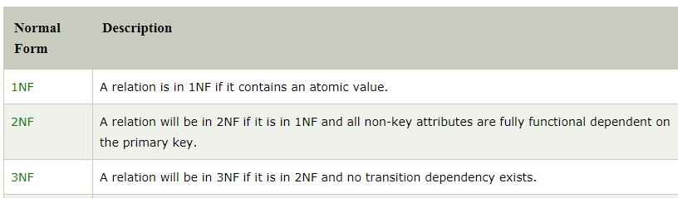
Normal Form Rules

Slide 9
First normal form (1NF)
A relation will be 1NF if it contains an atomic value.
It states that an attribute of a table cannot hold multiple values. It must hold only single-valued attribute.
First normal form disallows the multi-valued attribute, composite attribute, and their combinations.
Example:
Relation EMPLOYEE is not in 1NF because of multi-valued attribute EMP_PHONE.

Slide 10
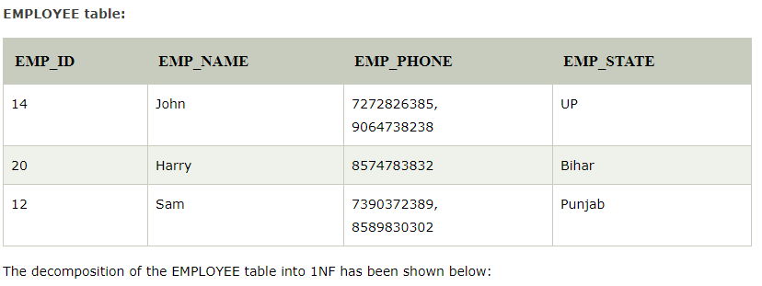
First normal form (1NF)

Slide 11
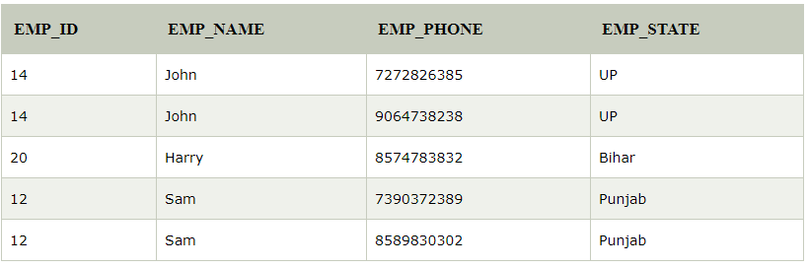
First normal form (1NF)

Slide 12
Second normal form (2NF)
In the 2NF, relational must be in 1NF.
In the second normal form, all non-key attributes are fully functional dependent on the primary key
Example:
Let's assume, a school can store the data of teachers and the subjects they teach. In a school, a teacher can teach more than one subject.

Slide 13
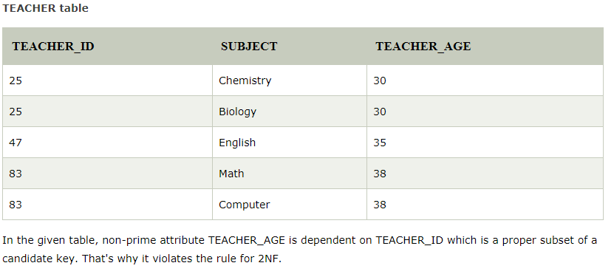
Second normal form (2NF)

Slide 14
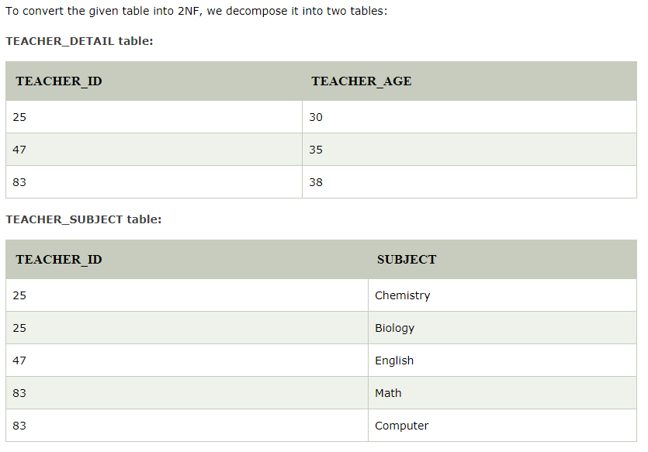
Second normal form (2NF)

Slide 15
Third normal form (3NF)
A relation will be in 3NF if it is in 2NF and not contain any transitive partial dependency.
3NF is used to reduce the data duplication. It is also used to achieve the data integrity.
If there is no transitive dependency for non-prime attributes, then the relation must be in third normal form.
A relation is in third normal form if it holds at least one of the following conditions for every non-trivial function dependency X→ Y.
1. X is a super key.
2. Y is a prime attribute, i.e., each element of Y is part of some candidate key.

Slide 16
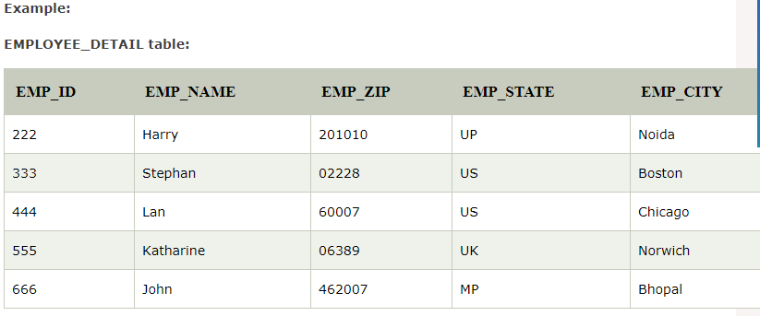
Third normal form (3NF)

Slide 17
Third normal form (3NF)
Super key in the table above:
{EMP_ID}, {EMP_ID, EMP_NAME}, {EMP_ID, EMP_NAME, EMP_ZIP}....so on
Candidate key: {EMP_ID}
Non-prime attributes: In the given table, all attributes except EMP_ID are non-prime.
Here, EMP_STATE & EMP_CITY dependent on EMP_ZIP and EMP_ZIP dependent on EMP_ID. The non-prime attributes (EMP_STATE, EMP_CITY) transitively dependent on super key(EMP_ID). It violates the rule of third normal form.
That's why we need to move the EMP_CITY and EMP_STATE to the new <EMPLOYEE_ZIP> table, with EMP_ZIP as a Primary key.

Slide 18
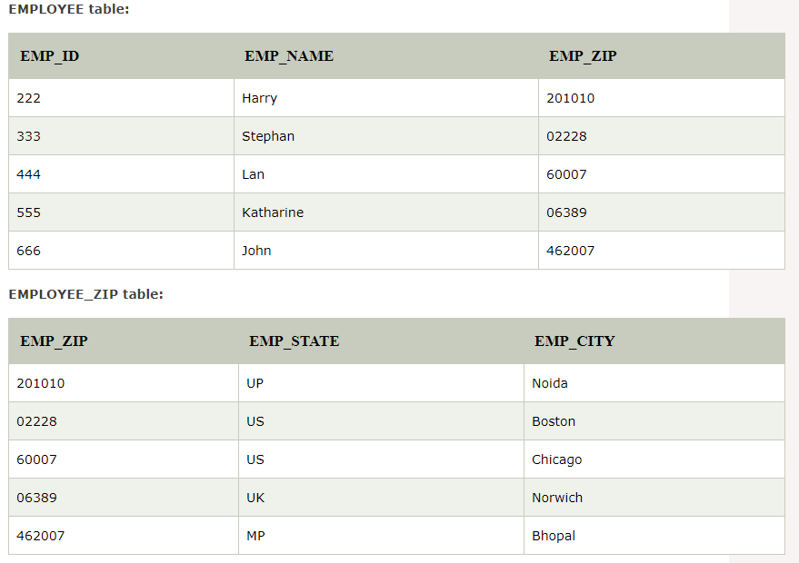
Third normal form (3NF)

Slide 19
Functional Dependency
The functional dependency is a relationship that exists between two attributes. It typically exists between the primary key and non-key attribute within a table.
X → Y
The left side of FD is known as a determinant, the right side of the production is known as a dependent.
For example:
Assume we have an employee table with attributes: Emp_Id, Emp_Name, Emp_Address.
Here Emp_Id attribute can uniquely identify the Emp_Name attribute of employee table because if we know the Emp_Id, we can tell that employee name associated with it.
Functional dependency can be written as:
Emp_Id → Emp_Name
We can say that Emp_Name is functionally dependent on Emp_Id.

Slide 20
Types of Functional dependency
1. Trivial functional dependency
A → B has trivial functional dependency if B is a subset of A.
The following dependencies are also trivial like: A → A, B → B
Example:
Consider a table with two columns Employee_Id and Employee_Name.
{Employee_id, Employee_Name} → Employee_Id is a trivial functional dependency
as Employee_Id is a subset of {Employee_Id, Employee_Name}.
Also, Employee_Id → Employee_Id and Employee_Name → Employee_Name are
trivial dependencies too.
2. Non-trivial functional dependency
A → B has a non-trivial functional dependency if B is not a subset of A.
When A intersection B is NULL, then A → B is called as complete non-trivial.
Example:
ID → Name,
Name → DOB

